Slide 1


CompSci club
Computer Science Careers and Concentrations
Are you interested in pursuing further in CS? Even if you’re not, Computer Science is used everywhere!

Slide 2

Our person of the day!
Luis von Ahn
Sticking with our celebration of Hispanic Heritage month, today we honor Guatemalan Luis Von Ahn, whose technologies you might interact with every single day
He earned his Bachelor of Science in Mathematics from Duke University before earning his PhD in Computer Science at Carnegie Mellon
In the early 2000s, we worked with another Hispanic Computer Scientist to develop CAPTCHAs, and in 2007 he invented the now widely-adopted reCAPTCHA
He sold reCAPTCHA to Google in 2009 for $10 to 100 million dollars (the actual value is undisclosed)
Two years later, he developed Duolingo, which revolutionized learning things online (crowdsourcing)
In May, Duolingo was valued at more than $1.5 billion
Pioneer of Crowdsourcing
Notes:
Very well written article about von ahn on business insider! https://www.businessinsider.com/luis-von-ahn-creator-of-duolingo-recaptcha-2014-3

Slide 3
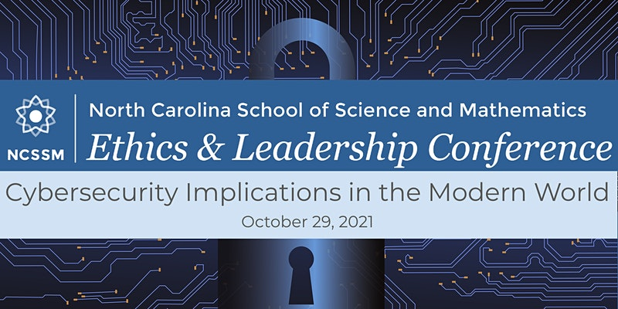
Opportunities Board
This is something that we will do periodically, or as frequently we get chances to show you things!
These are upcoming CS events or activities that we think you might enjoy — usually they will have something for all experience levels
The North Carolina School of Science and Math (NCSSM) is holding an virtual Ethics and Leadership Conference on October 29, 8:30 to 4
This year’s topic is Cybersecurity and Computer Science Implications in the Modern World
The event is totally free, and we might hold a watch party during lunch
If you are interested, visit https://elc.ncssm.edu/home
You get a free shirt and stickers as well!

Slide 4


Roadmap for Today
Computer Science Careers
There are so many things to explore! We will try to give you an overview!
Discussion
If we have some time at the end, we want to hear your thoughts! What’s jumps out?

Slide 5
Jobs can be boring — don’t let yours
Let’s look at some
Computer Science Careers

Slide 6


Careers in Web Development
Have you ever wanted to develop your own websites on the internet, or work with massive databases that drive the web?
Web Development may the right career for you then!
In Web Development, there are two major options that you can choose
Front End - What the user sees when they interact with the page
Languages: jQuery, HTML, CSS
Back End - Where the data and logic is housed
Languages: Node.js, Python, PHP
Parts of Web Development also strongly overlap with Cloud Computing, which is deploying programs and applications virtually on the cloud

Slide 7


Careers in Game Development
Game Development probably needs little introduction: It is the process of creating video games for people to enjoy
Game Development is especially appealing if you enjoy the Fine Arts, as there is an array of chances for you to design visual aspects of games
An critical part of Game Development (and all coding, but Game Dev especially) is debugging
You don’t want glitches in your games!
Game Development can also lead you to a career in game design, utilizing software like Unity and Unreal Engine
Coding wise, the most common Game Dev languages are C++ and Java

Slide 8



Careers in AI & Machine learning
If there is one career that is going to explode in the next few years, it will be AI and Machine Learning
In the coming years, three is a projected shortage in AI specialist and AI psychologists
AI is perfect if you want to combine other interdisciplinaries such as robotics and deep learning
Neural Networks are a CS concept that has spread to other fields like Physics, and are a series of artificial neurons that mimic the human brain
If you are someone who wants to be at the cutting-edge of new technology and trying to predict the future, AI might be for you
Notes:
If you’d like to learn more about neural networks! https://www.ibm.com/cloud/learn/neural-networks

Slide 9


Careers in Data Science
If you are someone who likes making predictions based on statistics (and less of a machine learning algorithm), Data Science sounds right for you!
Using real-world data and statistical models to forecast the probability of events, Data Science combines Computer Science, Math and facets of AI into one concentration
There is a lot of application for Data Science in Businesses, who use it to monitor and foresee their financial statuses
At the core of Data Science is trying to solve real-world problems, making it applicable to any field you can think of, from healthcare to transportation
Python and R are particularly great for Data Science!
Notes:
This is the data science textbook i have used, highly recommend! https://inferentialthinking.com/chapters/intro.html

Slide 10


Careers in Cybersecurity
If you are someone who likes to crack puzzles and decipher codes, Cybersecurity would be a wonderful fit
Cybersecurity allows you to interact with hardware and software as you discover the ways that hackers exploit security vulnerabilities
Many schools and businesses cold hackathons, which incorporate Cyber Security aspects but also other aspects of programming and design
You can win a lot of money with some of these, just sayin’
Every one of these aforementioned careers wouldn’t be able to flourish without some sort of protection; that is what cyber security ensures!

Slide 11
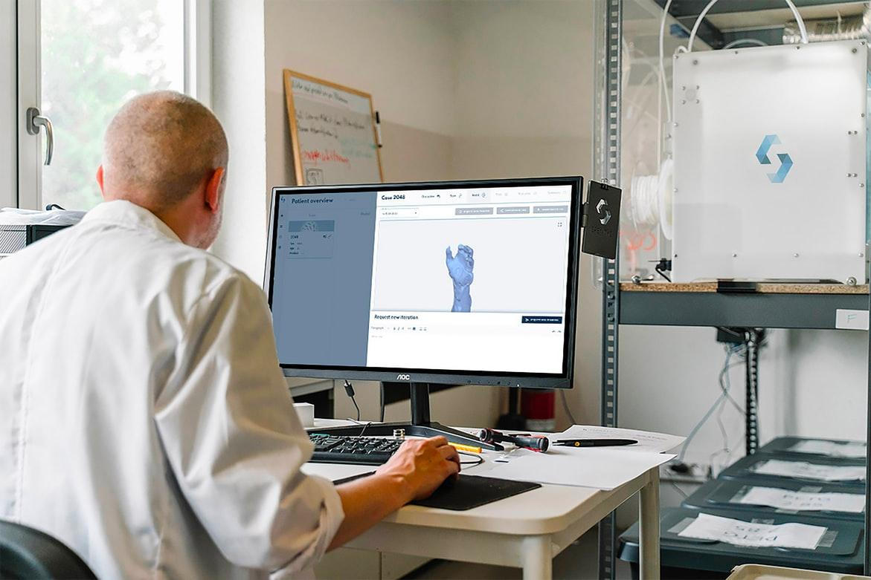

A note about Big Tech
We know for some of you, CS isn’t the career that you are necessarily looking to go into
However, there are countless jobs and professions that integrate some form of Computer Science, that even knowing a little can be a massive advantage
Medical - Health Informatics is when CS and Healthcare collide, and it involves using algorithms and modeling to gather information about genome and patient records
Education - Currently, there is a shortage of Computer Science faculty at universities, partially due to the lucrative jobs at companies
Art - Video game design isn’t the only field where CS and art cross; UX and animators designers with CS experience can be a valuable tool!

Slide 12
We would love to hear your thoughts now!
It’s time for
Discussion!

Slide 13
We will be back to coding and new material next week!
Thank you!
That is all we have for today!

